Slide 1


Slide 2
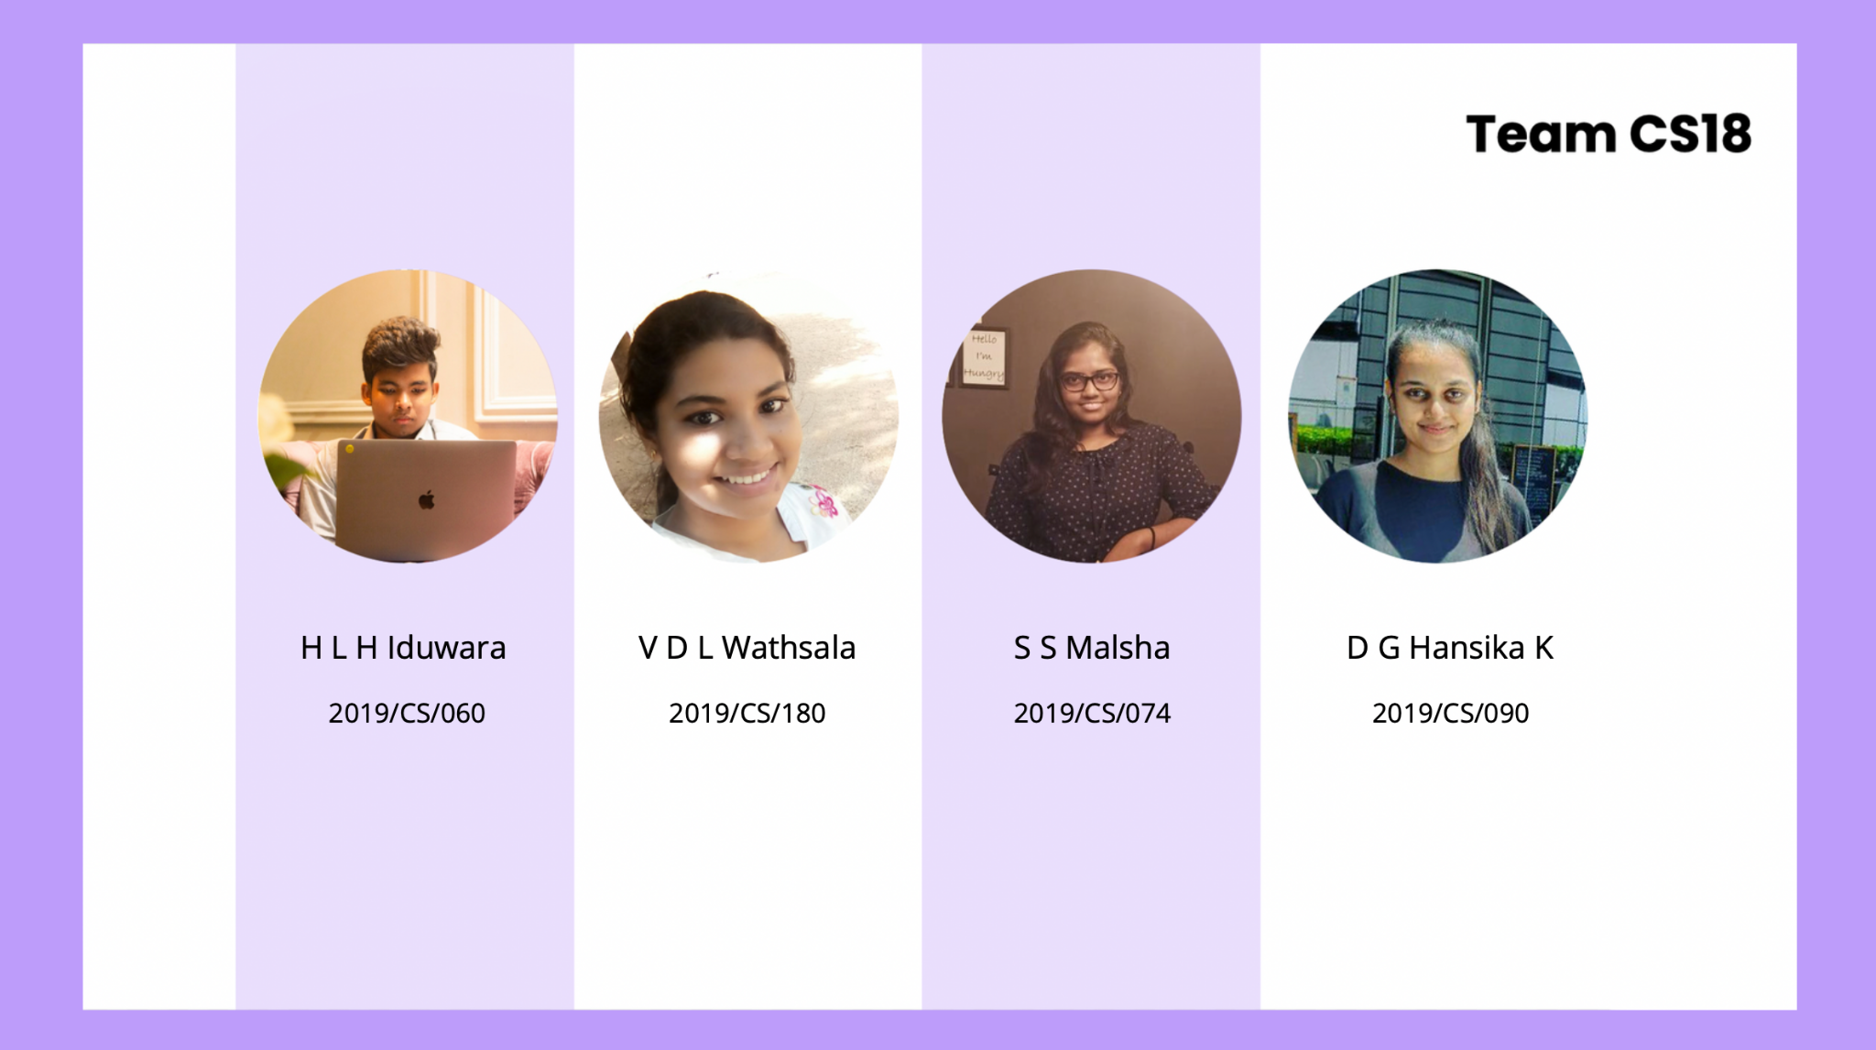
Supervisor : Ms Sanduni Thrimahavithana
Co-Supervisor : Mr Akila Gamage

Slide 3


ON SERVICE PROVIDER’S END
PROBLEM DEFINITION
PANDEMIC SITUATION
FINDING A PLATFORM TO PROVIDE THEIR SERVICES
FINDING GENUINE CUSTOMERS
PAYING HIGH AMOUNT OF FEES
ON HIRE PERSON’S END
PANDEMIC SITUATION
FINDING TALENTED SERVICE PROVIDERS
EVERYTHING GETTING DIGITIZED.

Slide 4

Freelancing Platform To Everyone Who Are Willing To Provide Services And Looking For A Service Provider To Get Any Kind Of IT Related Task Done.

Slide 5

WADAK

Slide 6
Service Provider
Hire Person
Admin
Co-Admin
STAKEHOLDERS

Slide 7
Web Application For Stakeholders
Deliverables
User Manual

Slide 8


FUNCTIONAL
REQUIREMENTS

Slide 9

Login
Logout
Handle Co-admins
Handle Service Providers
Handle Hire Persons
Handle Categories
View Reports
ADMIN

Slide 10


Login
Logout
Handle Service Providers
Handle Hire Persons
Handle Posts
Handle News
Handle Q&A Session
Handle Advertisements
Chat with service providers and hire persons
CO-ADMIN

Slide 11

Login
Logout
Register To The System
Deactivate Account
Chat With Co-Admin
Chat With Hire Persons And Service Providers
Maintain Profile
Online Payments For Advertisement
Engage In An Q&A Session
HIRE
PERSON &
SERVICE
PROVIDER

Slide 12


SERVICE
PROVIDER
View Job Posts
Send And Cancel Job Applications
Handle Job Post
Accept Or Reject Job Applications

Slide 13


HIRE
PERSON
View service providers
Report service providers
Rate and review service providers
Accept or reject job applications
Handle job posts
Send and cancel invitations

Slide 14

Provide Smart Suggestions
Provide Filtering Criteria
Provide Badges
Leaderboard
generate Reports Based On The Current Users Of The System
Facilitate for Online Payment Method (Advanced Payment for Advertisements.)
Notifications
SYSTEM

Slide 15
MAINTAINABILITY
AVAILABILITY
PORTABILITY
USABILITY
RELIABILITY
SECURITY
PERFORMANCE
TESTABILITY
TARGET QUALITY ATTRIBUTES

Slide 16

USE CASE DIAGRAMS

Slide 17

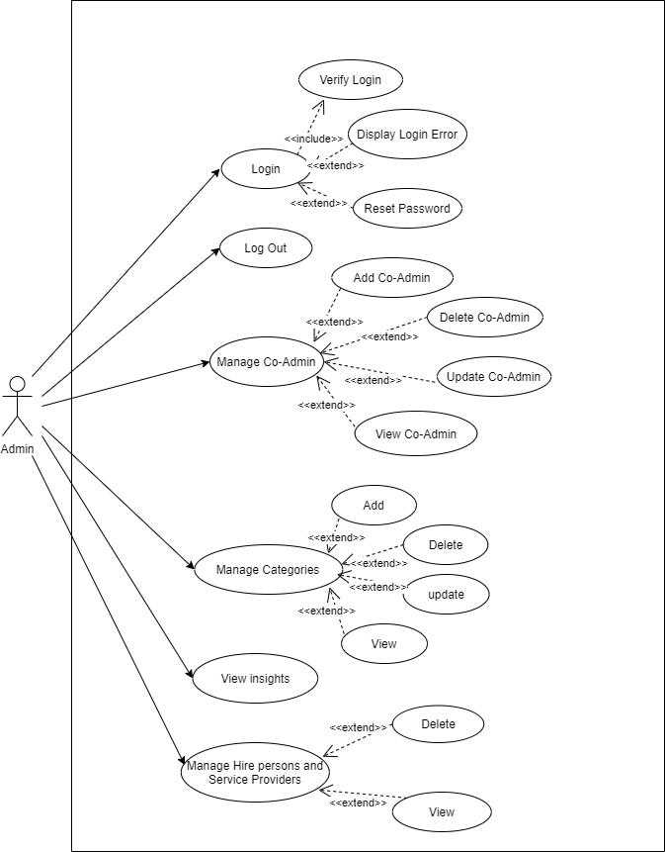
ADMIN

Slide 18
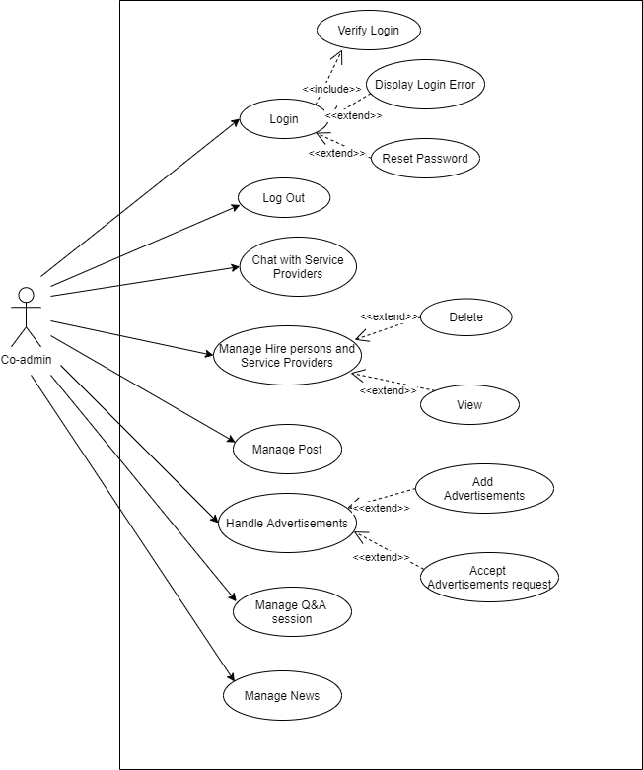
CO-ADMIN

Slide 19
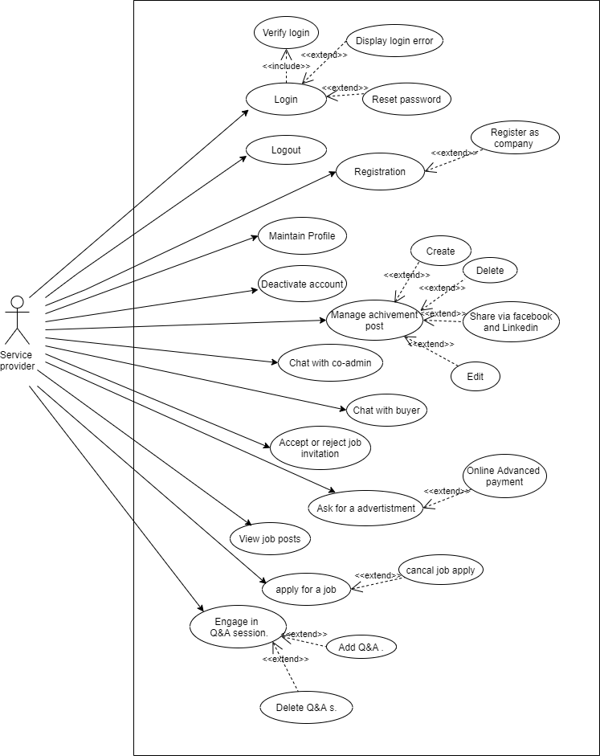
SERVICE
PROVIDER

Slide 20
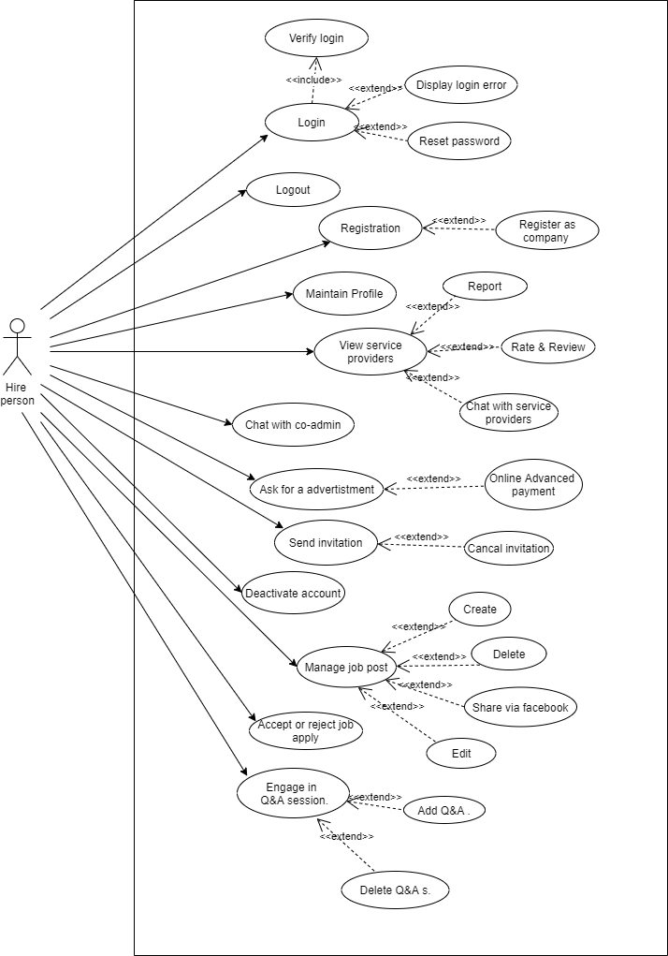
HIRE
PERSON

Slide 21
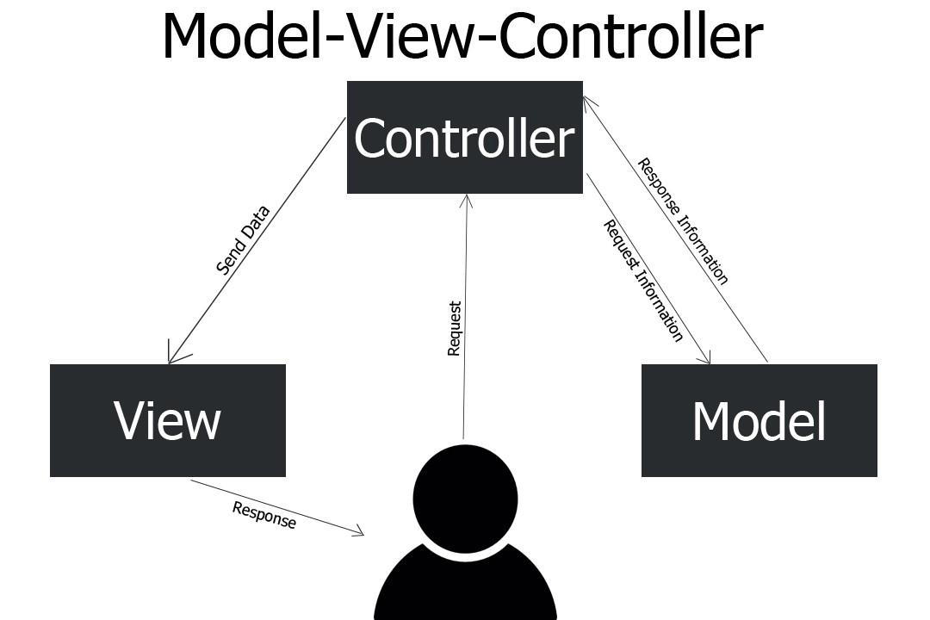
HIGH-LEVEL ARCHITECTURE

Slide 22
USABILITY & USER EXPERIENCE

Slide 24
TESTING

Slide 25
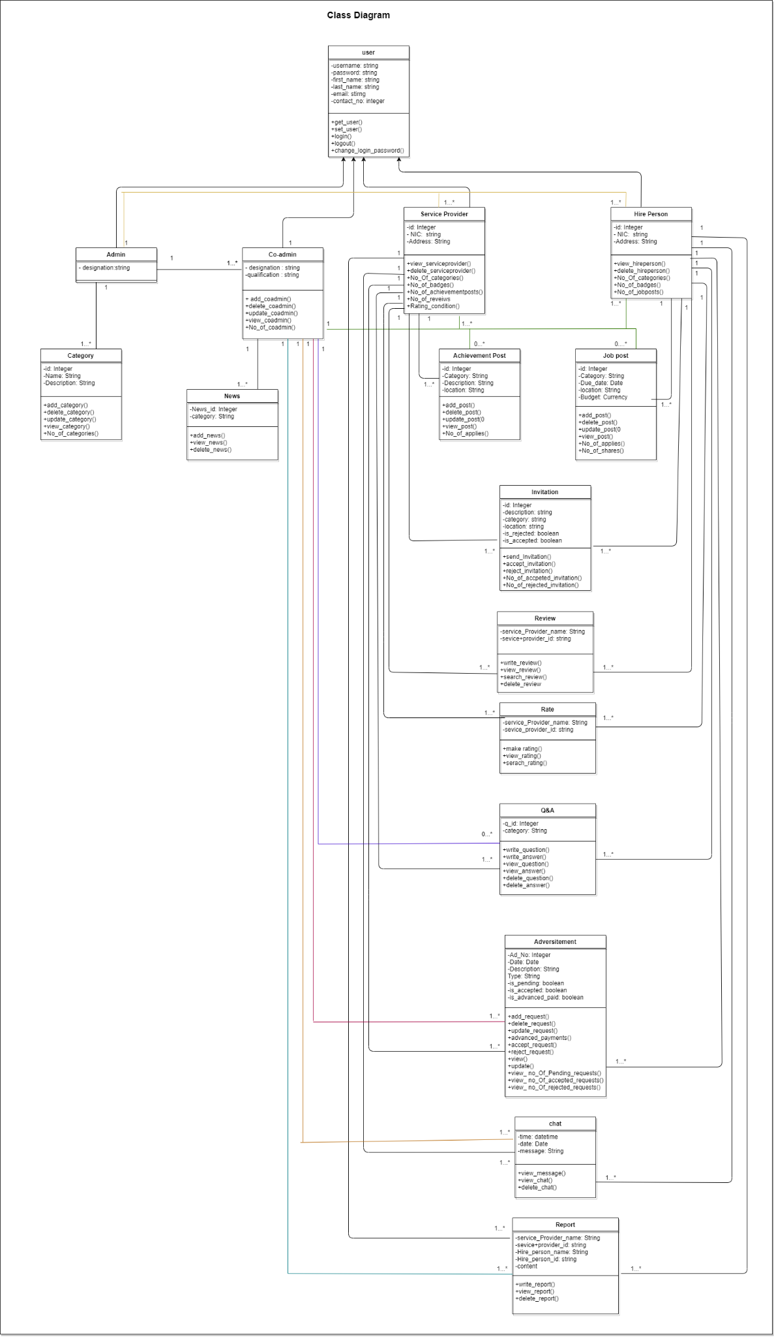
CLASS
DIAGRAM

Slide 26
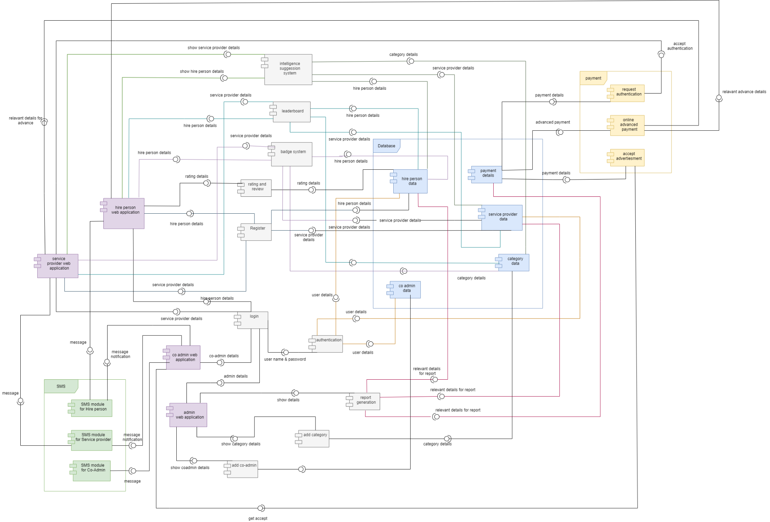
COMPONENT
DIAGRAM

Slide 27





Technologies Used
Front End
Back End
HTML5
CSS3
MySql
JavaScript
PHP

Slide 28



Version
Controlling
Code Editor

Slide 29

PROGRESS SO FAR

Slide 30
OVERALL SYSTEM COMPLETION
35-40%
10%
50-55%
Completed
In progress
To do

Slide 31

QUALITY
ASSURANCE

Slide 32

BEST PRACTISES

Slide 33
INDIVIDUAL CONTRIBUTION
Commenting
Avoid Duplication
Maintaining readability
- Correct indentation

Slide 34
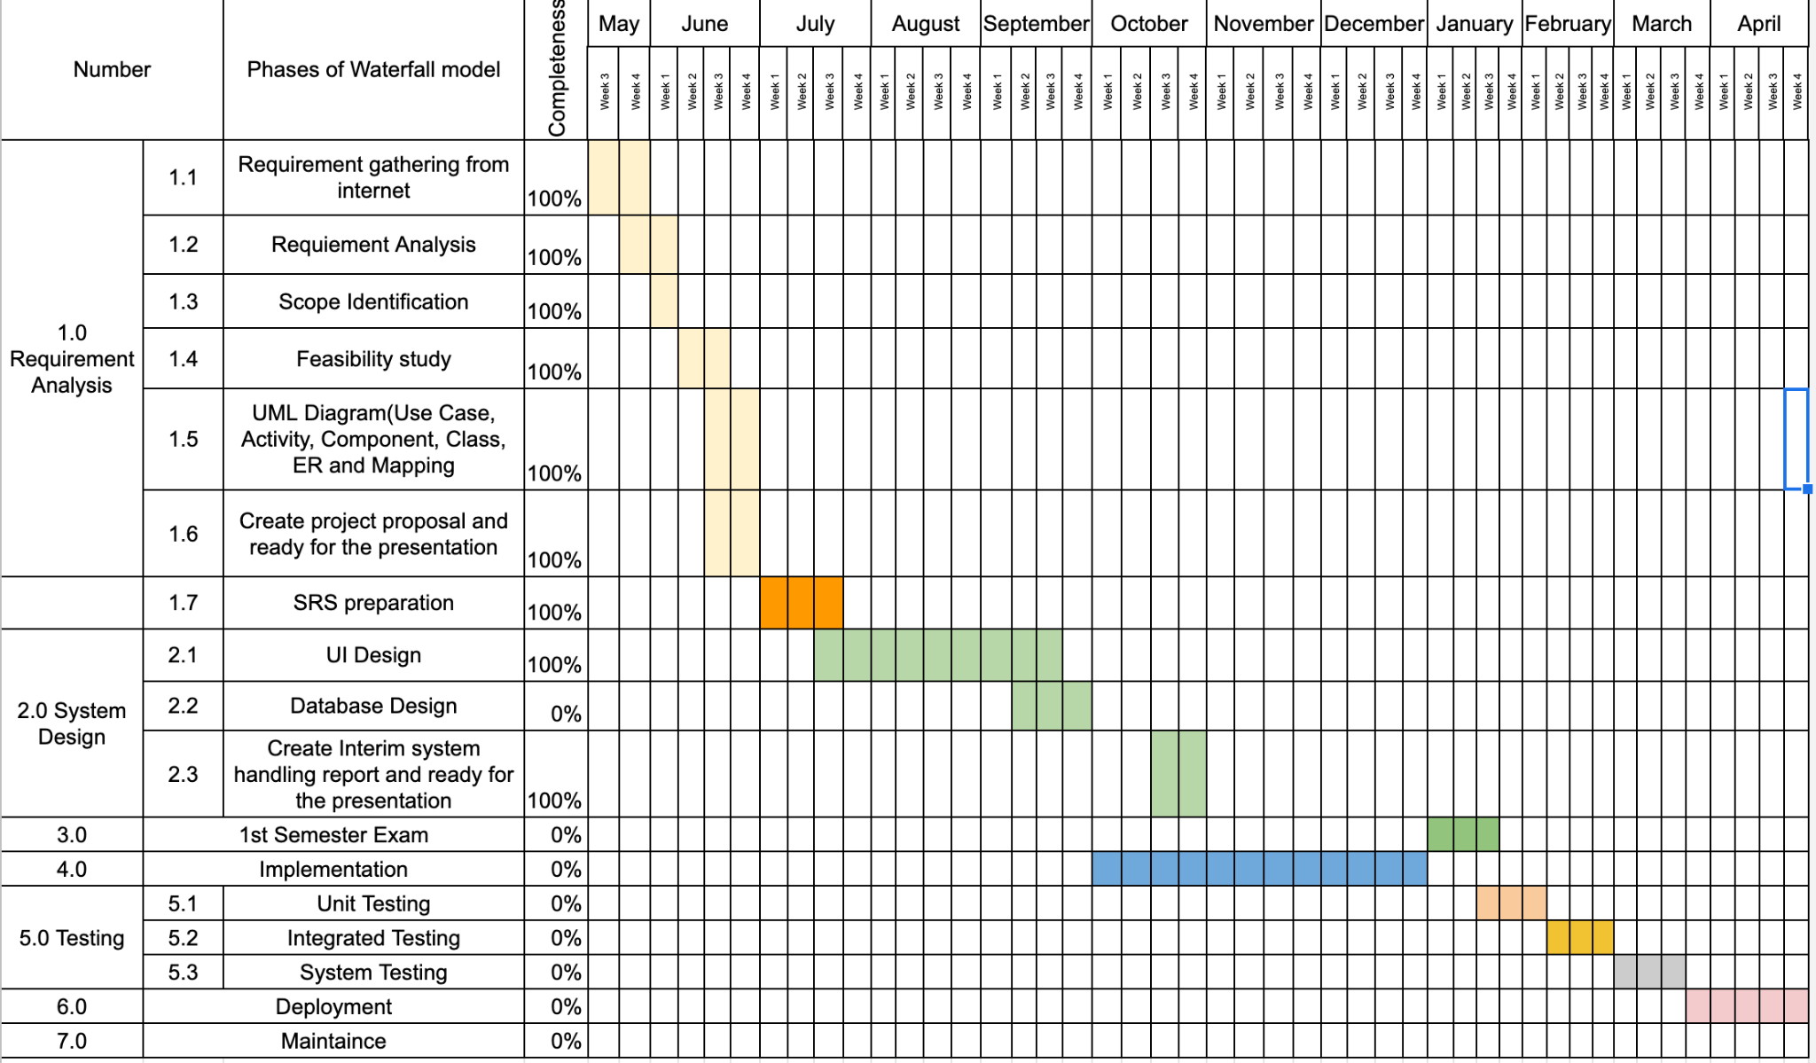
PROJECT DELIVERY TIMELINE

Slide 35
THANK YOU

Slide 36
TO THE DEMONSTRATION

